Slide 1
Mini Project 3 MiniChess AI
WSL Installation Tutorial

Slide 2
Outline
Introduction
Install WSL
Setup WSL
Install build-essential
Compile in WSL
Execute in WSL

Slide 3
Introduction
We have noticed that executing the project on Windows is much slower than on Mac or Linux
There also exists some serious problems like file remove error or baselines got killed too early and failed to output action
For Windows users, we recommend using WSL in this project to avoid these problems

Slide 4
Windows Subsystem for Linux
WSL enables your Windows computer to run Linux
Since the final evaluation will take place on a machine with Linux environment, using WSL during development is a good choice
Using WSL makes your code execute in normal speed
Without the lags in Windows
Also prevents the remove file and baseline invalid move error

Slide 5
Outline
Introduction
Install WSL
Setup WSL
Install build-essential
Compile in WSL
Execute in WSL

Slide 6
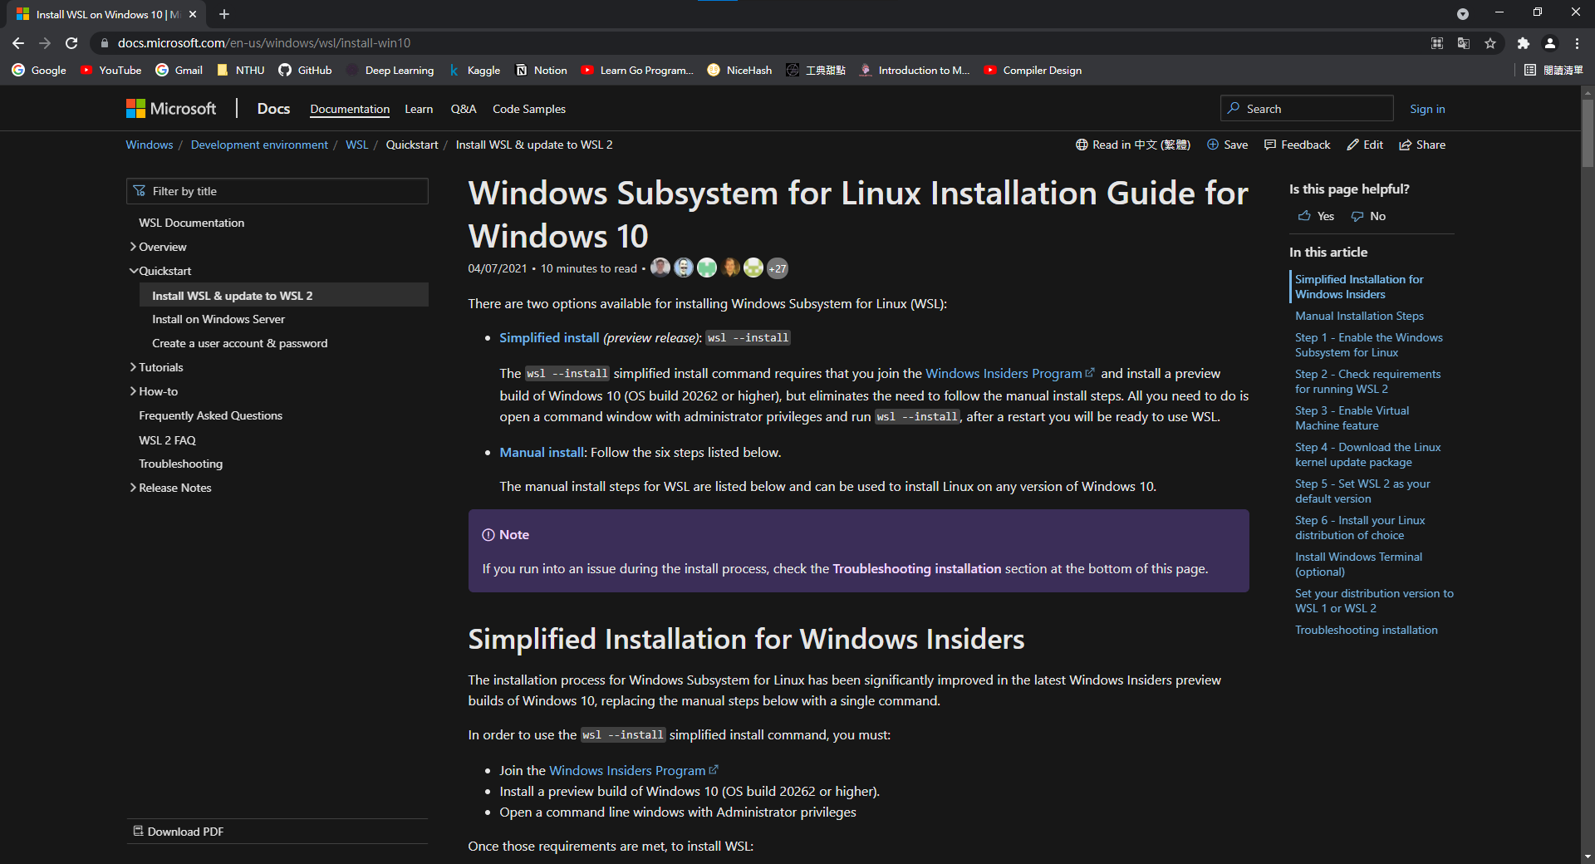
Go to WSL Installation Guide

Slide 7
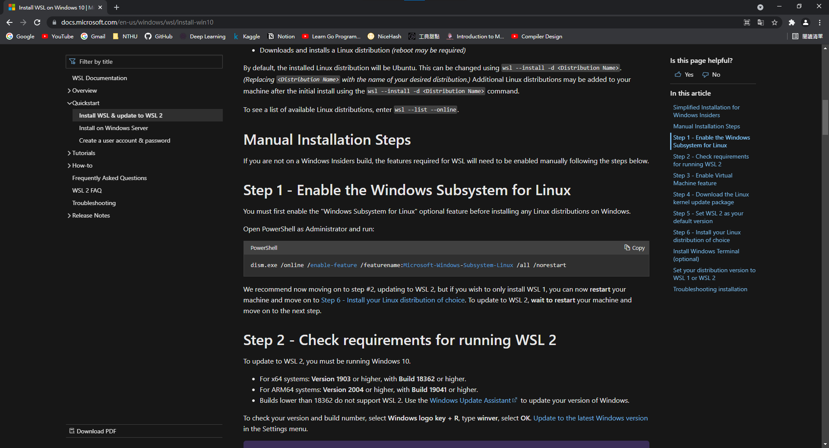
Copy the command in step 1

Slide 8
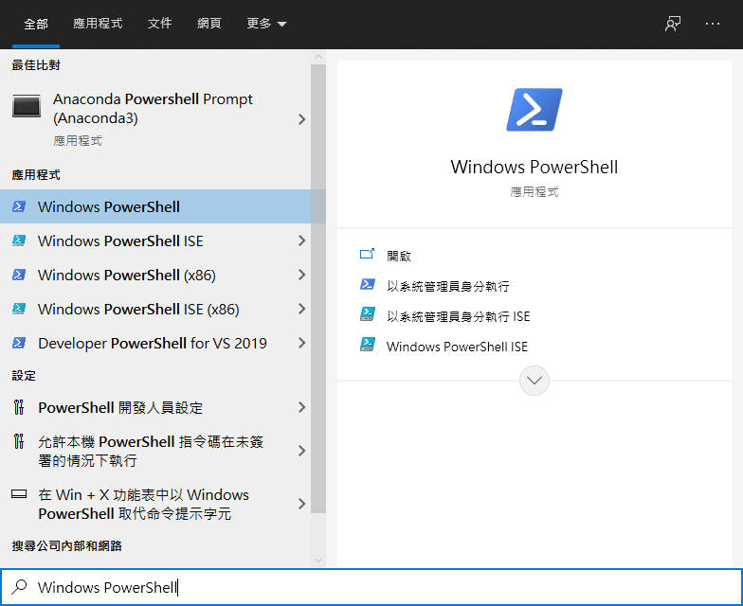
Search for PowerShell with search tool

Slide 9
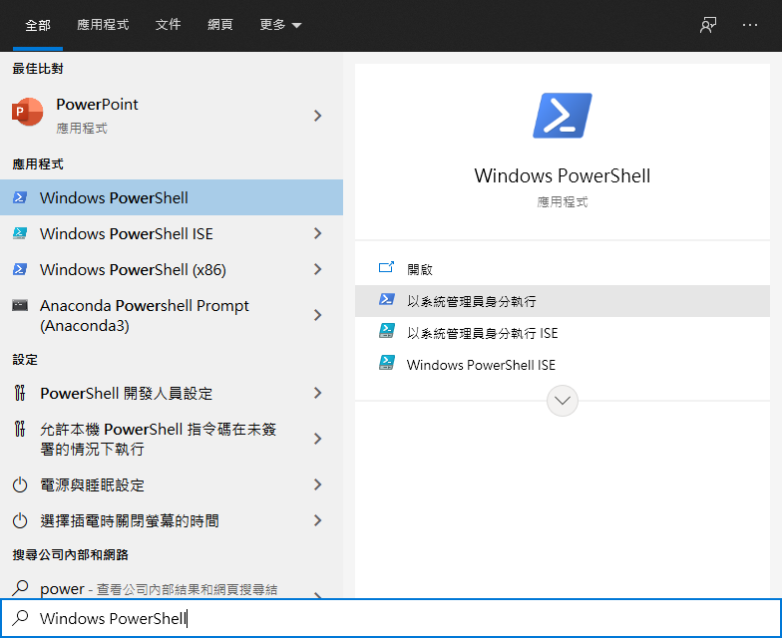
Open PowerShell as Administrator

Slide 10
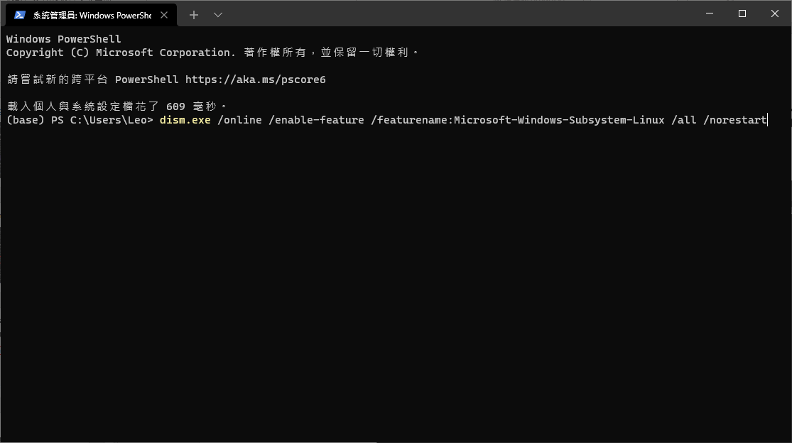
Paste the command and press enter

Slide 11
Restart your computer
Since WSL 1 is enough for this project, this slide will not go through step 2 ~ step 5 of the installation guide
Restart your computer before you proceed to next step
If there is “reboot” and “update and reboot”, click “update and reboot”
If you want to install WSL 2, you can follow the installation guide to complete step 2 ~ step 5 then restart your computer

Slide 12
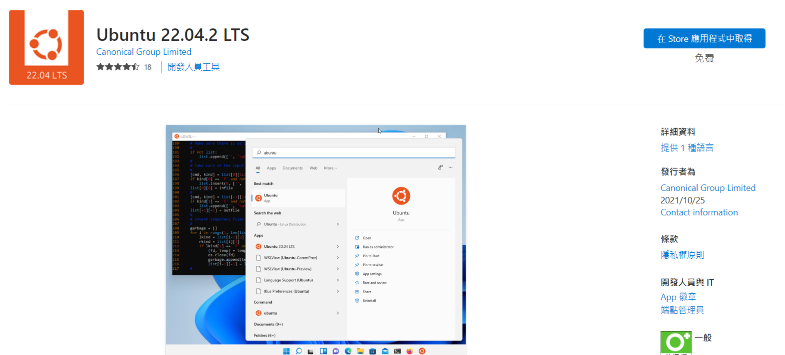
Install Ubuntu 22.04.2 LTS

Slide 13
Outline
Introduction
Install WSL
Setup WSL
Install build-essential
Compile in WSL
Execute in WSL

Slide 14
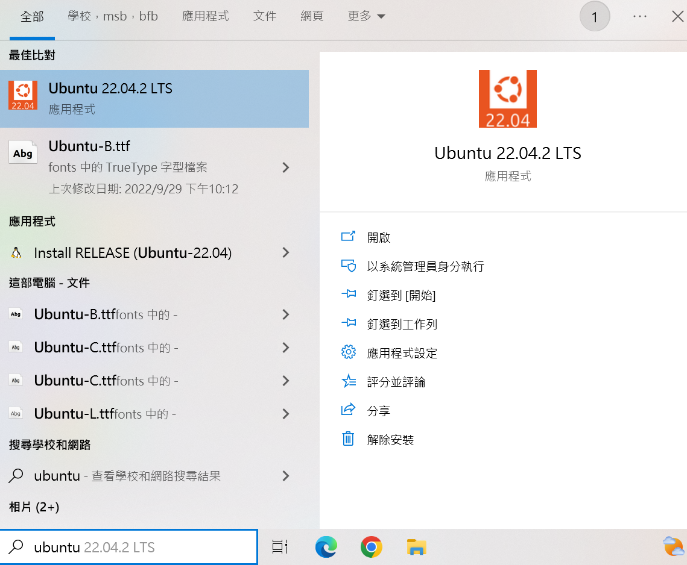
Search for Ubuntu and start it

Slide 15
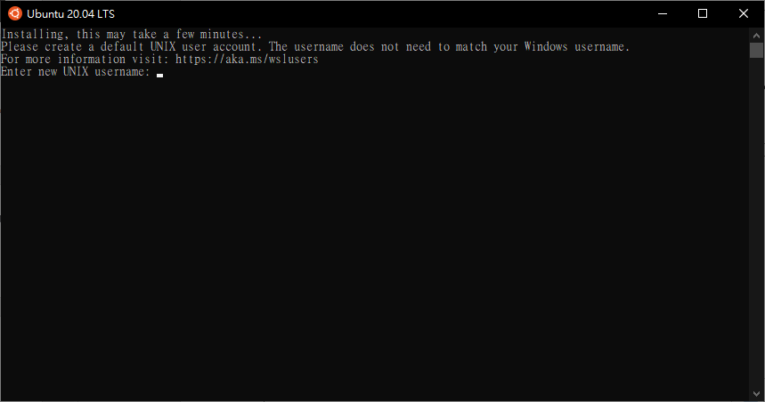
Enter your new username for Ubuntu

Slide 16
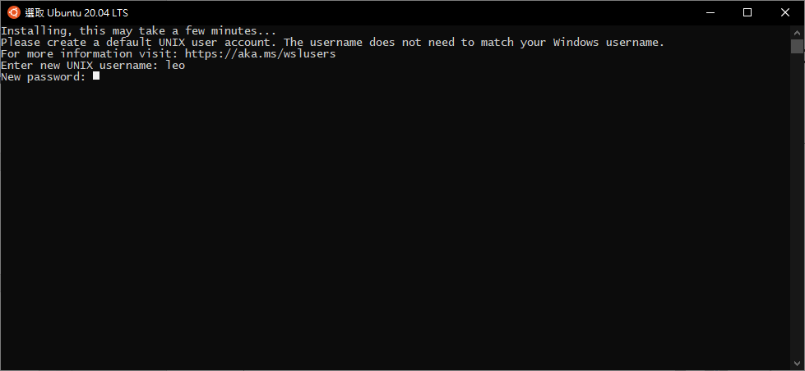
Enter your new password for Ubuntu

Slide 17
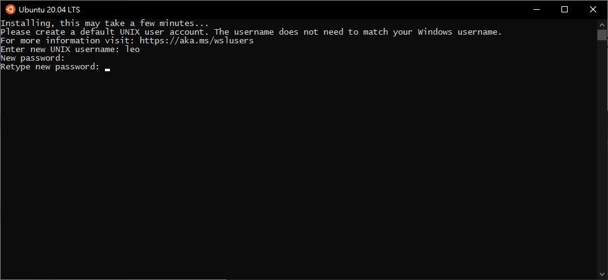
Validate your new password

Slide 18
Outline
Introduction
Install WSL
Setup WSL
Install build-essential
Compile in WSL
Execute in WSL

Slide 19
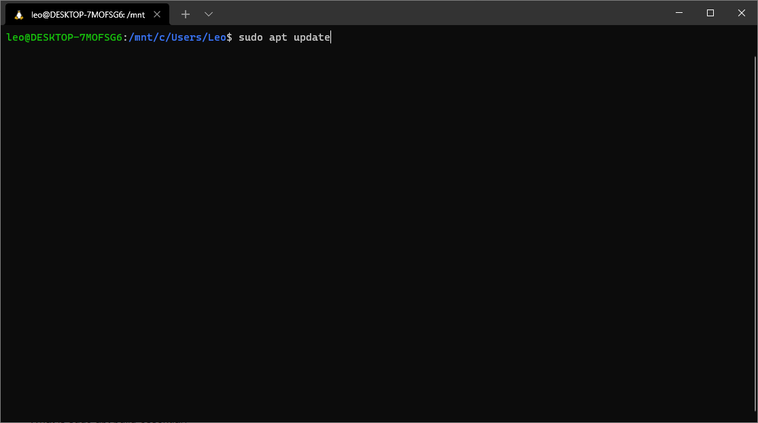
Enter “sudo apt update”

Slide 20
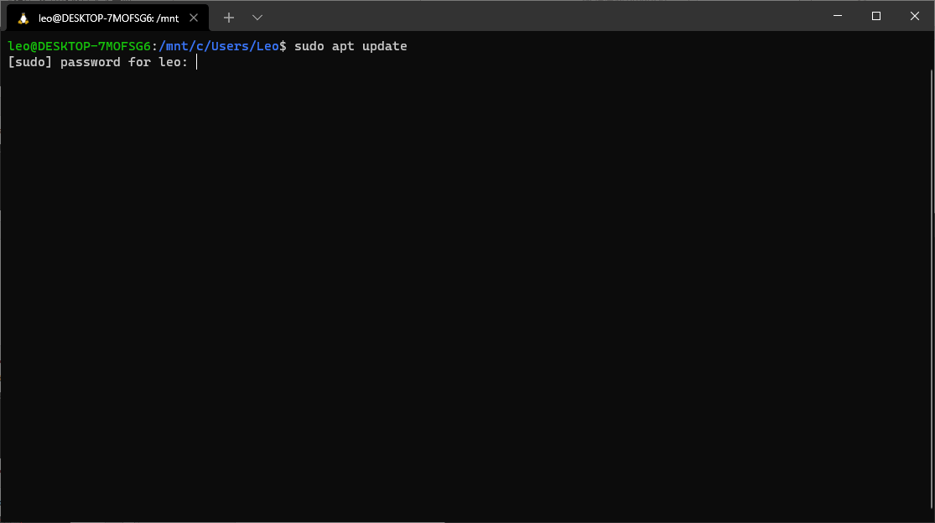
Enter your password for Ubuntu

Slide 21
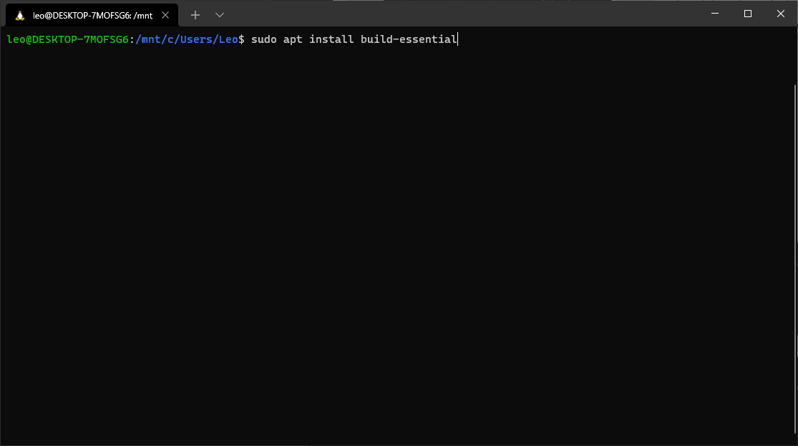
Enter “sudo apt install build-essential”

Slide 22
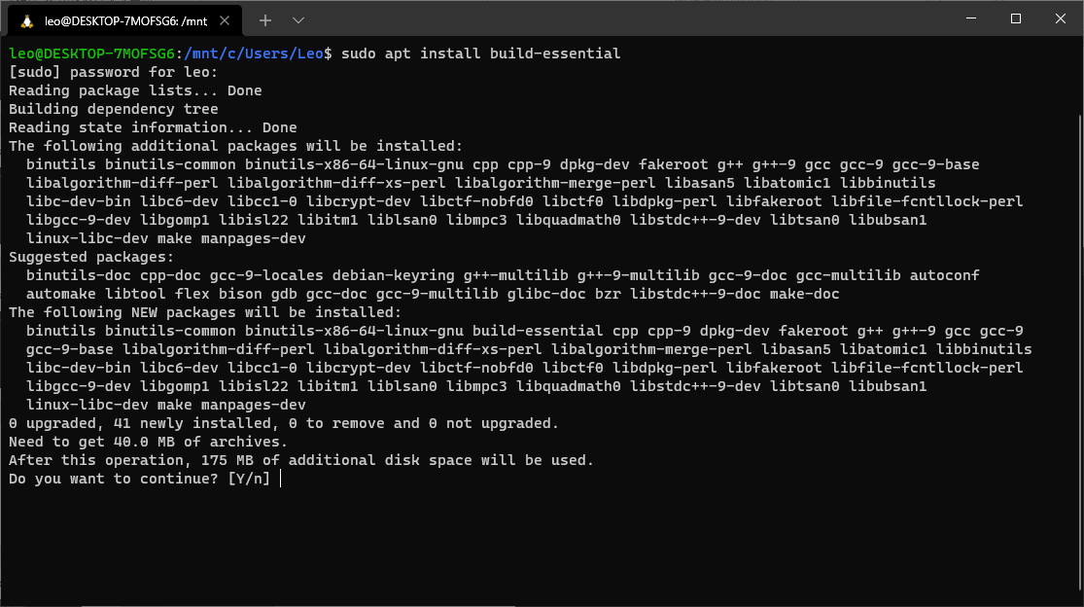
Press enter to continue

Slide 23
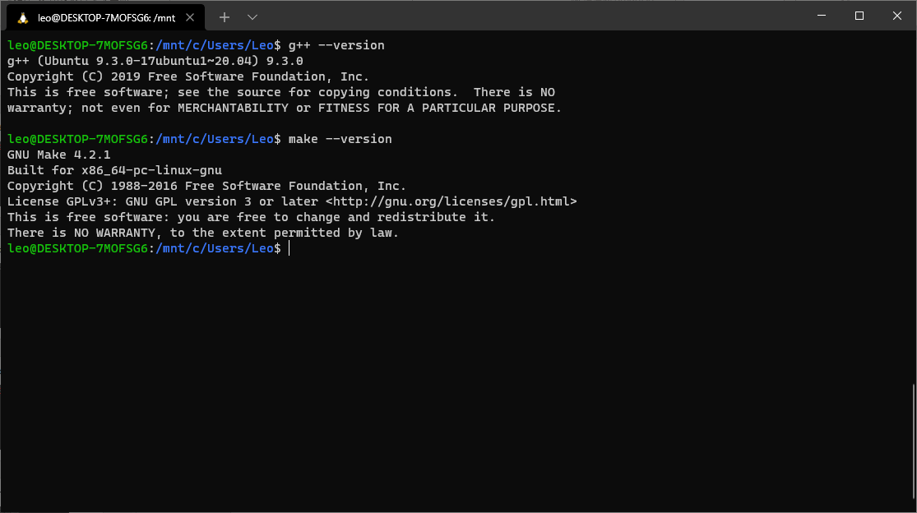
Type “g++ --version” and “make --version” to validate installation

Slide 24
Outline
Introduction
Install WSL
Setup WSL
Install build-essential
Compile in WSL
Execute in WSL

Slide 25
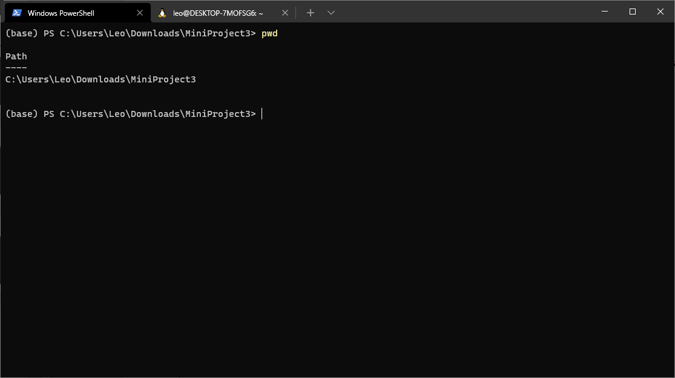
In Windows, your project path in C drive would be like “C:\[project_path]”

Slide 26
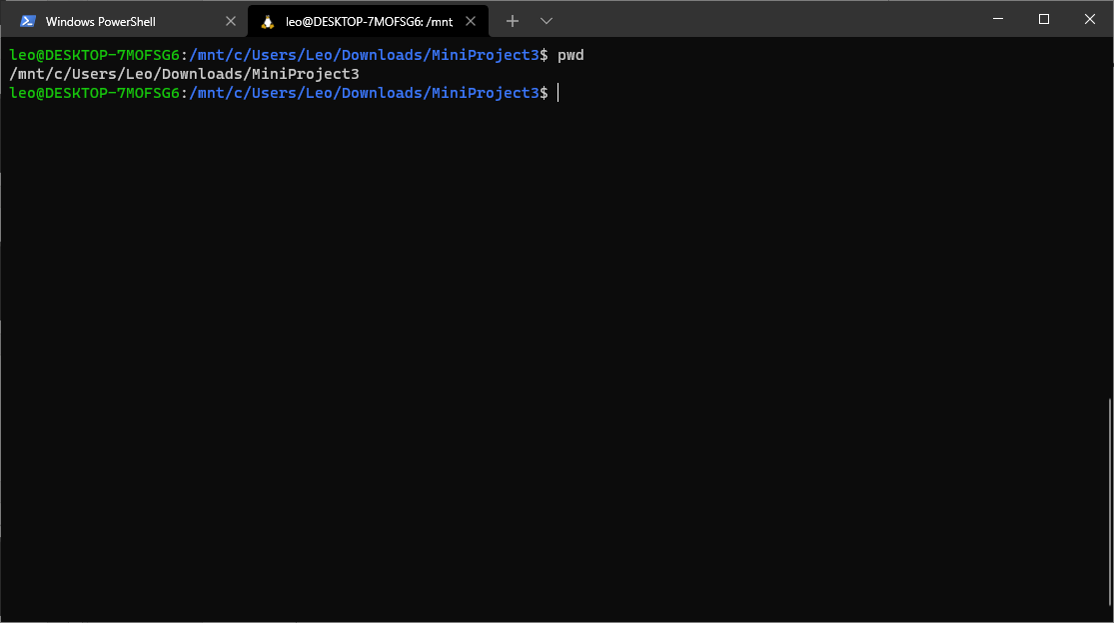
However, in WSL, your project path in C drive would be like “/mnt/c/[project_path]”

Slide 27
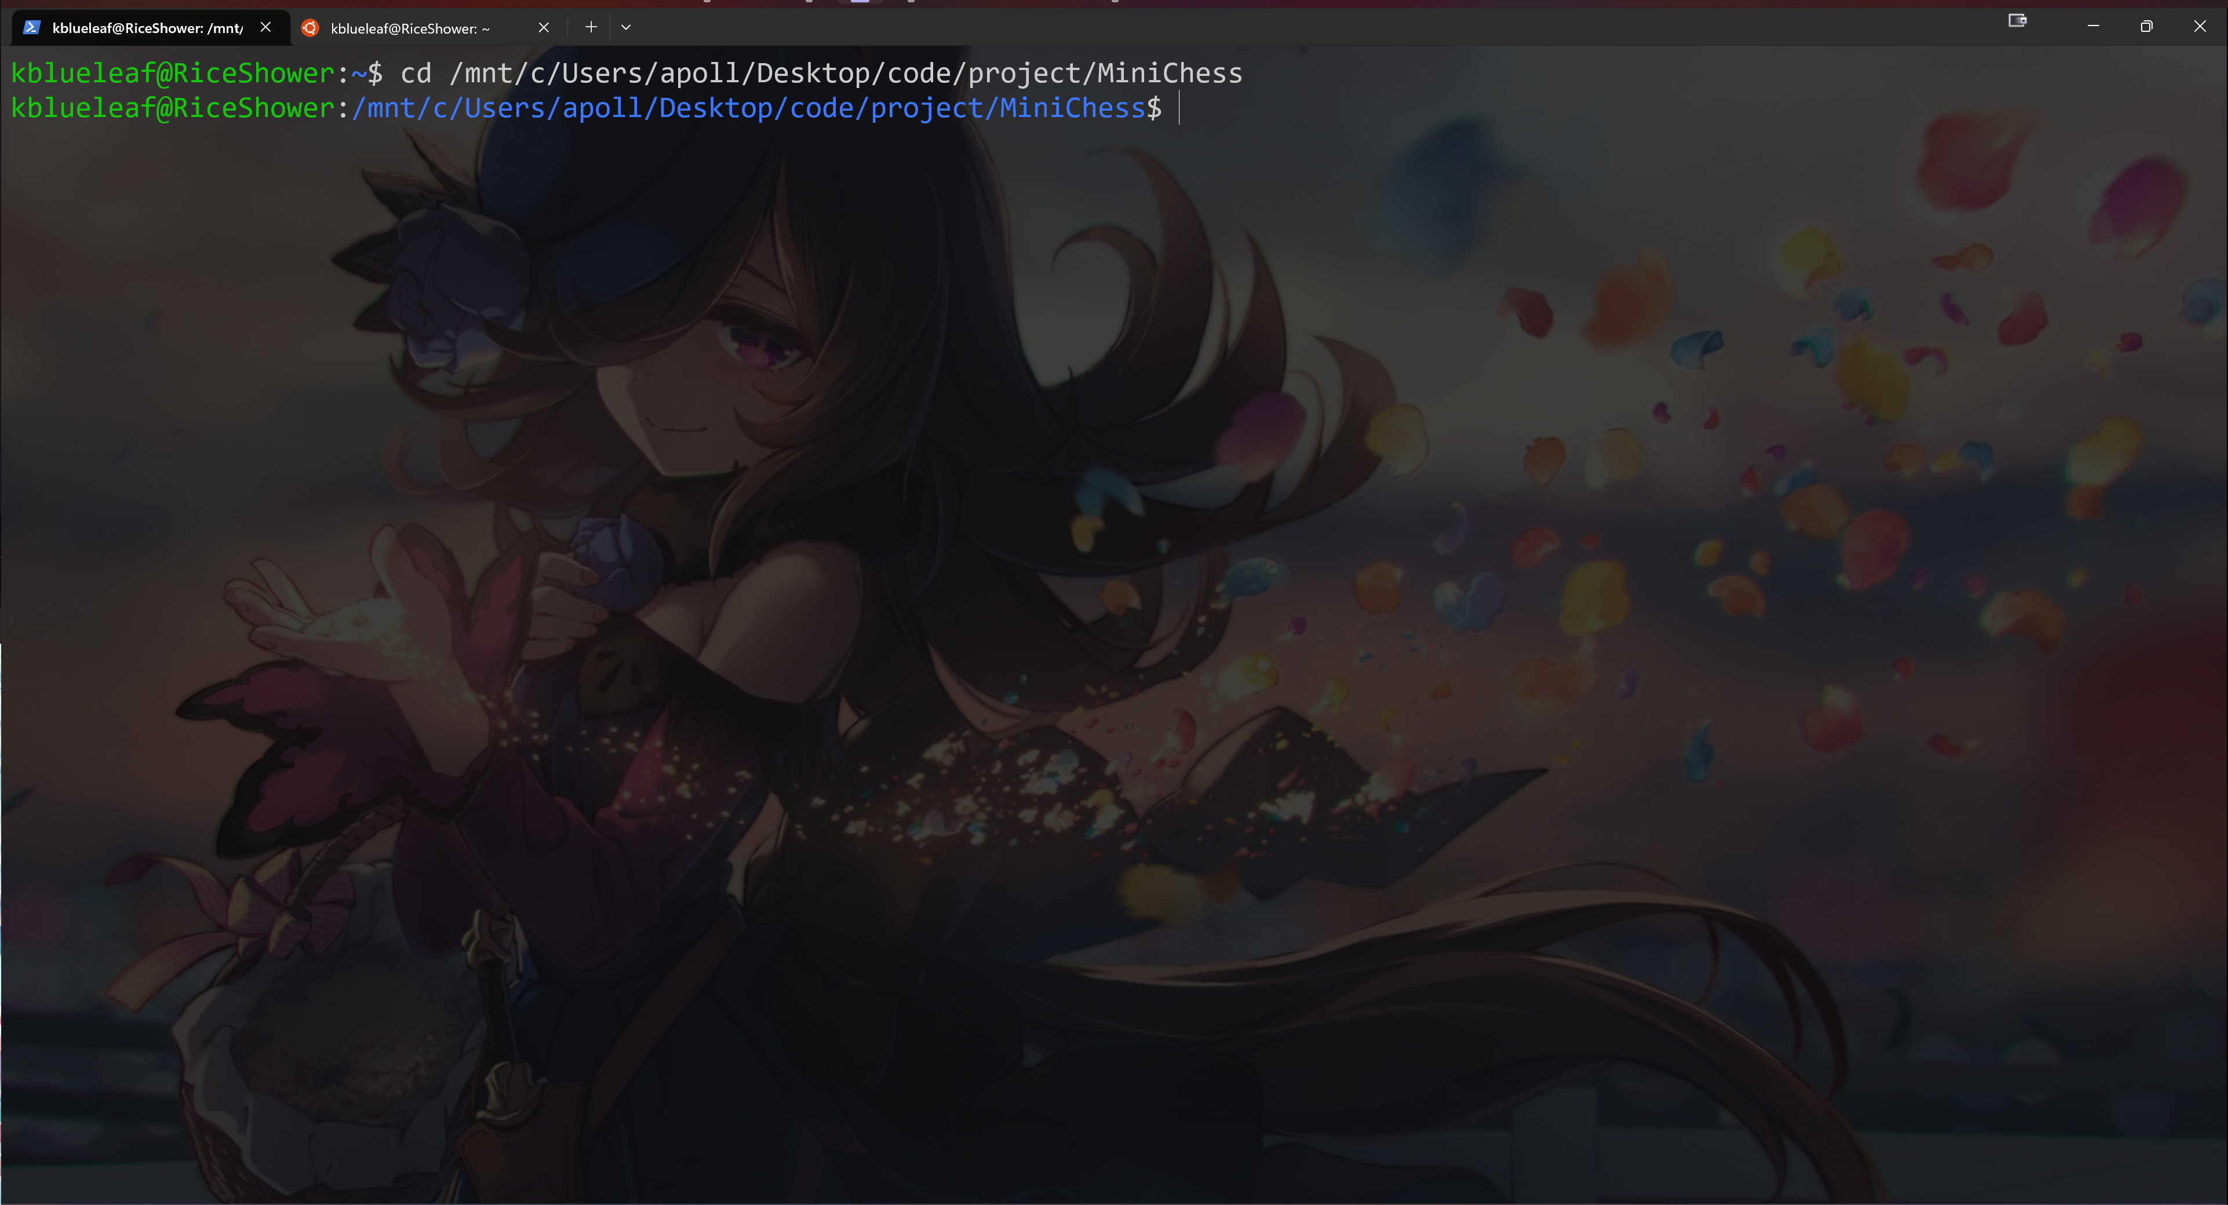
Change directory to the “project” folder of your project by “cd [project_path]”

Slide 28
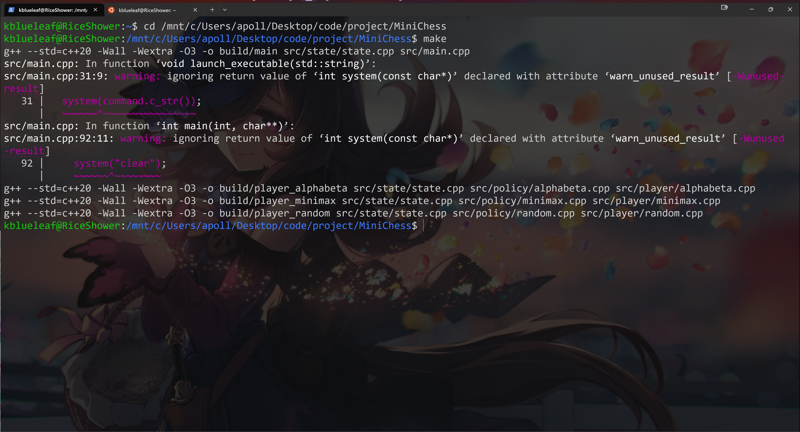
Type “make” to compile your code warning for main.cpp can be ignored

Slide 29
Outline
Introduction
Install WSL
Setup WSL
Install build-essential
Compile in WSL
Execute in WSL

Slide 30
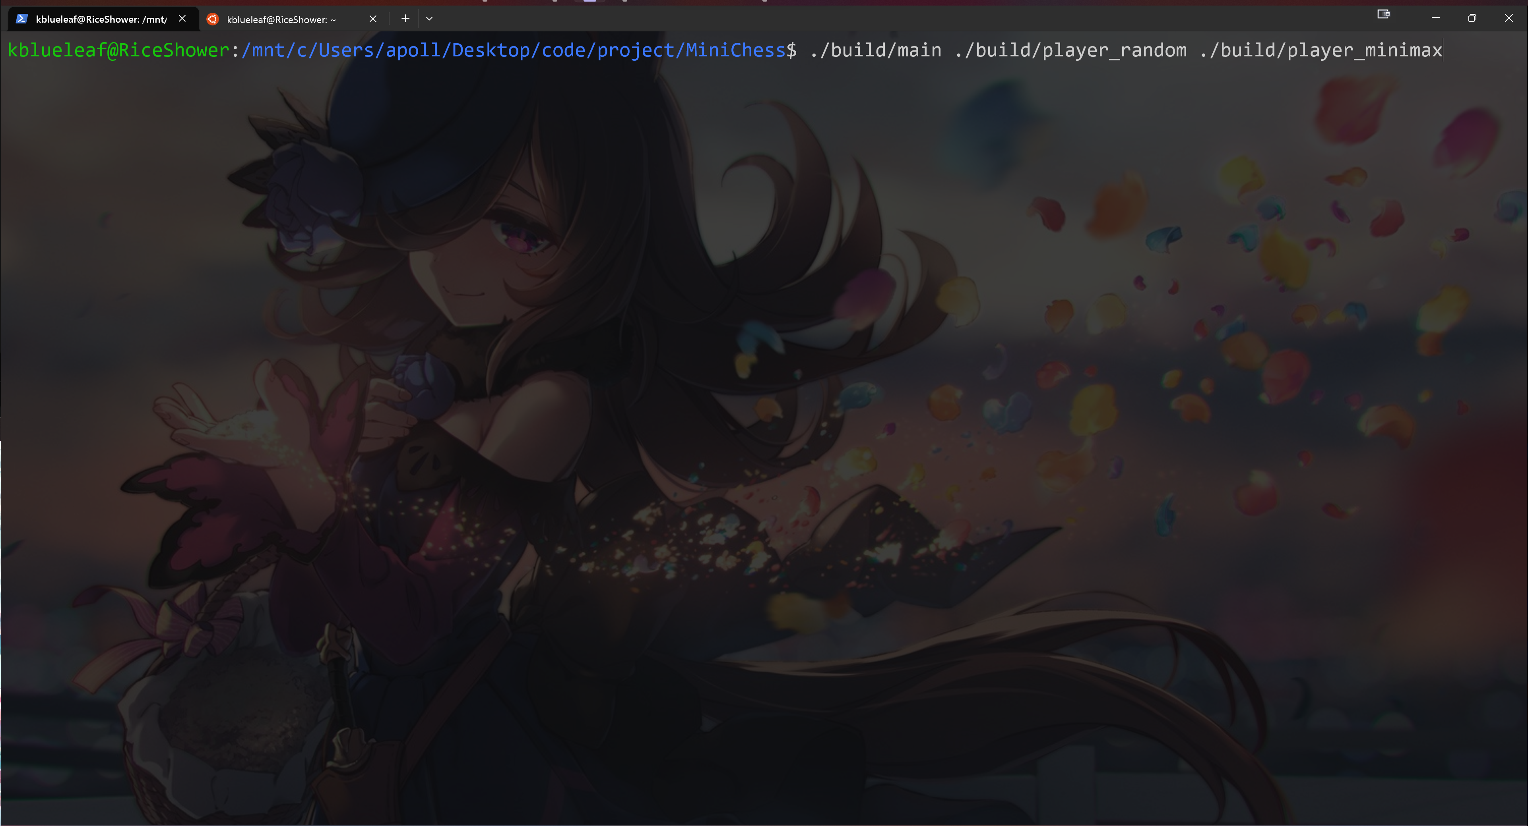
Type “./build/main ./build/[AI1] ./build/[AI2]” in terminal to execute while in the “[project_path]” folder of your project You can also choose AI file from other folder (like baseline)

Slide 32
Happy Coding!

